Slide 1
Simple Mean ,Median, Mode,
Standard deviation, Variance, Co Variance calculation using PYTHON; CODE FOR BINNING AND CODE FOR STATS and CHARTS using Python packages
By
Dr.D.VENKATA SUBRAMANIAN
GUEST FACULTY – BITS
MAY 9th 2020
dvsubramanian@wilp.bits-pilani.ac.in

Slide 2
Mean : The mean is the average of all numbers and is sometimes called the arithmetic mean. This code calculates Mean or Average of a list containing number
Mean = ∑X ÷ N
Here, ∑X= Sum of all the individual values and N= Total number of items

Slide 3
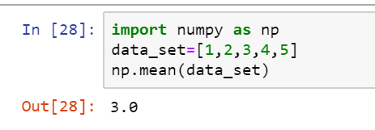
Python code for mean:
n_num = [1, 2, 3, 4, 5]
n = len(n_num)
get_sum = sum(n_num)
mean = get_sum / n
print("Mean is: " + str(mean))
Output:
Mean is: 3.0
Mean using python numpy:

Slide 4
Median:A median is the middle value of a data set. In the given n number of grouped or ungrouped data set in statistics, the median is the number found right in the middle of the data set.Median is calculated using the following formula.
Median = (n + 1) / 2

Slide 5
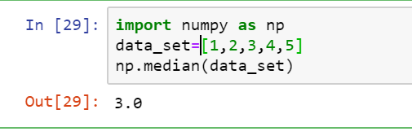
Python code for median:
n_num = [1, 2, 3, 4, 5]
n = len(n_num)
n_num.sort()
if n % 2 == 0:
median1 = n_num[n//2]
median2 = n_num[n//2 - 1]
median = (median1 + median2)/2
else:
median = n_num[n//2]
print("Median is: " + str(median))
Output:
Median is: 3
Median using python numpy:

Slide 6
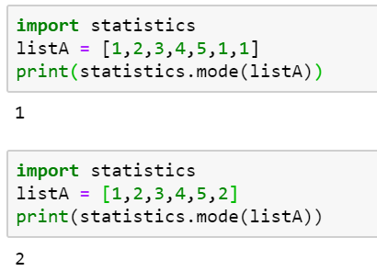
Mode:
The mode is the most frequently occurring score or value in the data set.
from collections import Counter
n_num = [1, 2, 3, 4, 5, 5]
n = len(n_num)
data = Counter(n_num)
get_mode = dict(data)
mode = [k for k, v in get_mode.items() if v == max(list(data.values()))]
if len(mode) == n:
get_mode = "No mode found"
else:
get_mode = "Mode is / are: " + ', '.join(map(str, mode))
print(get_mode)
Output:
Mode is / are: 5

Slide 7
Standard deviation and Variance :
Standard deviation is the square root of the arithmetic mean of the squares of deviations of observations from their mean value. It is generally denoted by sigma i.e. σ.
standard Deviation (σ)= √[∑D²/N]
Variance is the square of standard deviation.
Variance = ( Standard deviation)² = σ×σ

Slide 8
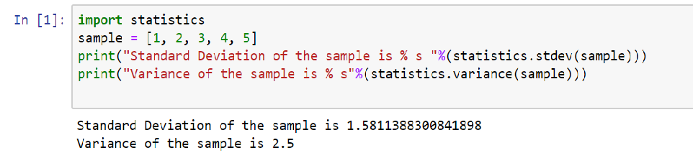
Python code for standard deviation and variance:
import math
xs = [1,2,3,4,5]
mean = sum(xs) / len(xs) # mean
var = sum(pow(x-mean,2) for x in xs) / len(xs) # variance
std = math.sqrt(var) # standard deviation
print(std)
print(var)
Output:
1.4142135623730951
2.0

Slide 9
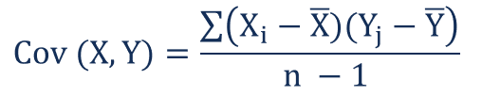
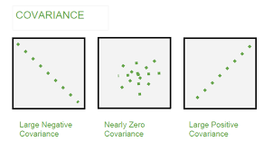
Formula for Covariance :
covariance is a measure of the relationship between two random variables. The metric evaluates how much – to what extent – the variables change together.
In other words, it is essentially a measure of the variance between two variables (note that the variance of one variable equals the variance of the other variable).
However, the metric does not assess the dependency between variables.
Where:
Xi – the values of the X-variable
Yj – the values of the Y-variable
X̄ – the mean (average) of the X-variable
Ȳ – the mean (average) of the Y-variable
n – the number of the data points

Slide 10
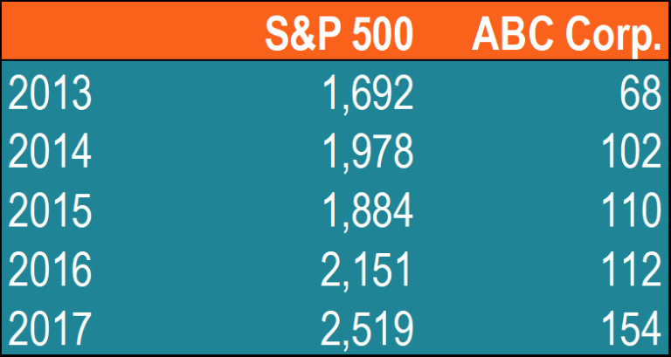
Example of Covariance
John is an investor. His portfolio primarily tracks the performance of the S&P 500 and John wants to add the stock of ABC Corp. Before adding the stock to his portfolio, he wants to assess the directional relationship between the stock and the S&P 500.John does not want to increase the unsystematic risk of his portfolio. Thus, he is not interested in owning securities in the portfolio that tend to move in the same direction.
How John can calculate the covariance between the stock of ABC Corp. and S&P 500?

Slide 11
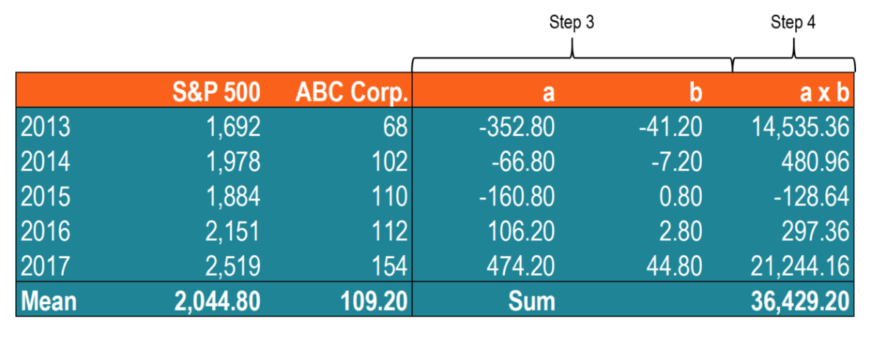
1. Obtain the data. First, John obtains the figures for both ABC Corp. stock and the S&P 500. 2. Calculate the mean (average) prices for each asset. 3. For each security, find the difference between each value and mean price. 4. Multiply the results obtained in the previous step. 5. Using the number calculated in step 4, find the covariance.
In such a case, the positive covariance indicates that the price of the stock and the S&P 500 tend to move in the same direction.

Slide 12
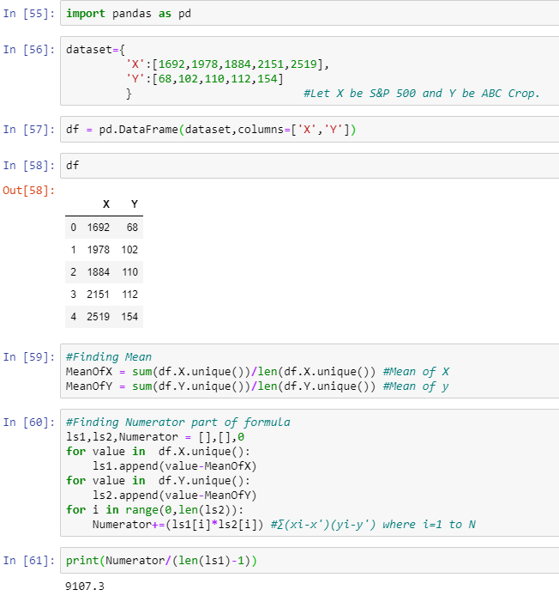
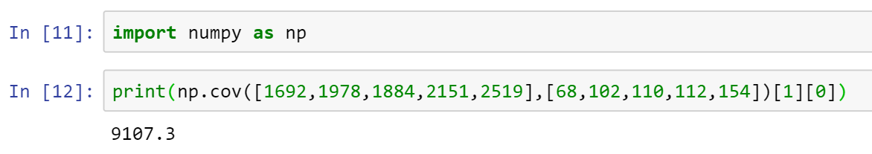
Python code to compute Covariance:
Using numpy :
│
│
│
│
│
│
│
│
│
│
│
│
│
│
│
│
│
│
│
│
│
│

Slide 13
Python code to compute Covariance:
Using numpy :
│
│
│
│
│
│
│
│
│
│
│
│
│
│
│
│
│
│
│
│
│
│

Slide 14
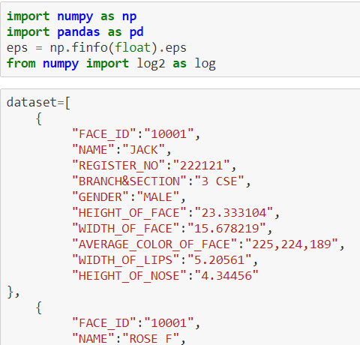
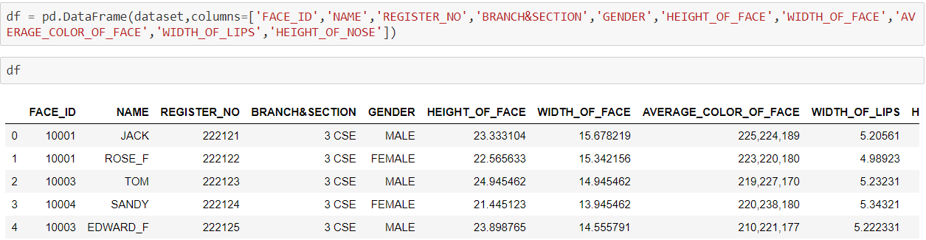
ALL STATISTICS IN ONE SIMPLE CODE/using api
iris.html has all the simple df and all the stats and histogram, box plot, etc
using the apis
binning.html has the simple binning data and binning techniques using python

